Slide 1

StockWatch
Chenson Johnson, Binju Shrestha, Samuel Khalil, David Osterhoff, Yunfan Yang, Zheng Zeng, Zhuoming Lei

Slide 2
Overview Sprint 4
We added buy and sell tab to the website
We updated our server
We used various flask extensions

Slide 3
Companies for
(Buy and sell)
General Electric
Ford
Boeing Aerospace Company
Apple Inc

Slide 4
Machine Learning
Building the model
We have begun building a model using larger numbers of steps (50000+)
Starting Training, Testing, and Validation Phases

Slide 5
Machine Learning Challenges
Building model is time consuming
is the model good? Overfitted?
positive reward values so far
Understanding outputs
Additional study is needed to completely understand what all the graphs mean
Figure out why reward graph doesn’t appear to work
Interpreting outputs into meaningful information for ordinary user

Slide 6
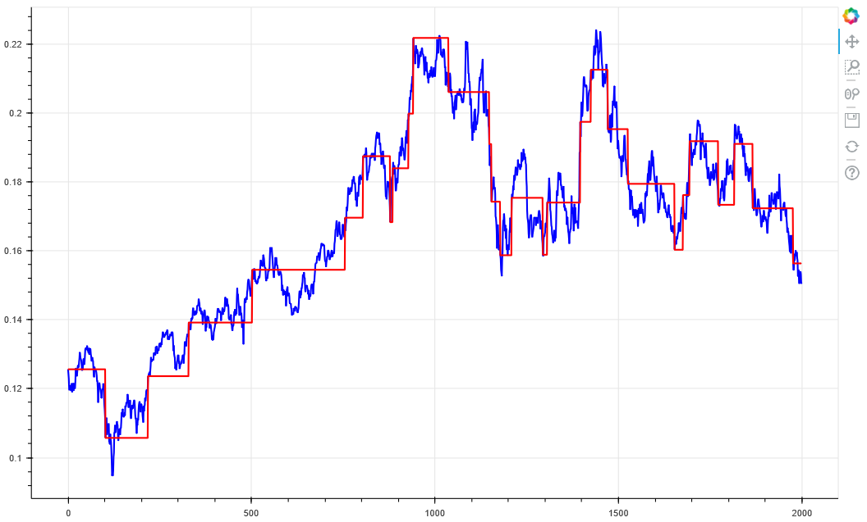
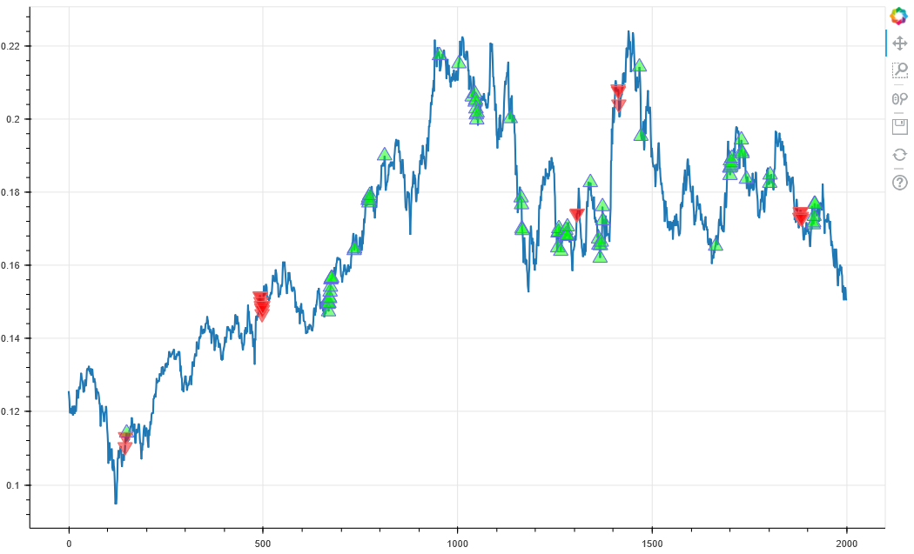
Left: Agent trail
Right: Agent Actions
GE historical stock data

Slide 7
Blue line:
Stock Trail (price)
Red Triangle:
Short (sell)
Green Triangle:
Long (buy)
View of Agent Actions

Slide 8
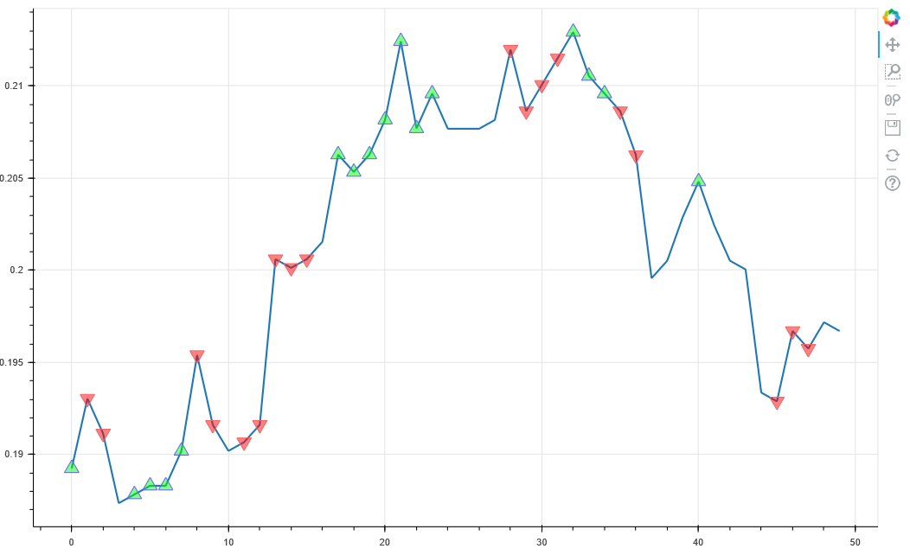
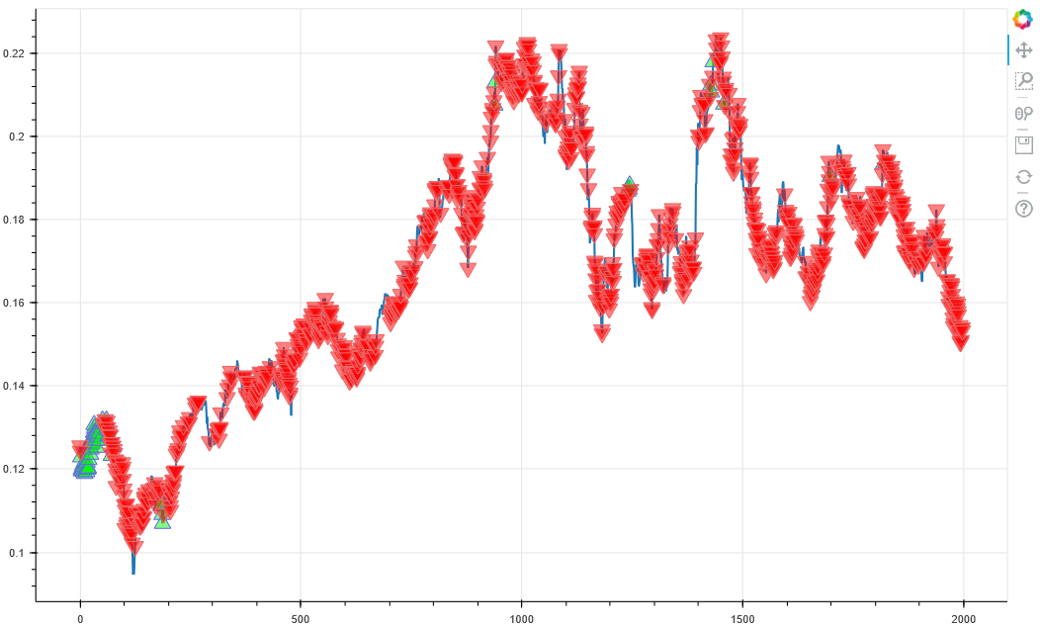
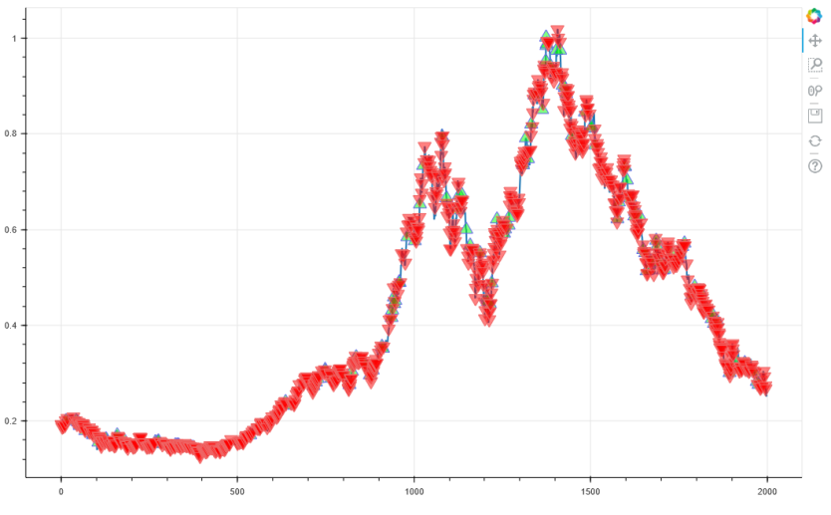
Improvement over time
1.
2.
3.
4.
Notes:
machine is making poor decisions. buying at peak prices, selling at low prices
machine is just making tons of guesses. seems kind of random
same as 2 but a little bit of improvement
machine is making better informed decisions. buys before price increase. sells before price decrease

Slide 9

Demo

Slide 10
Upcoming Sprint
Fine tune the ML code to be able to make more consistent profit
Merging of the code between frontend, backend, and algorithm.
Quality Assurance

